Slide 1
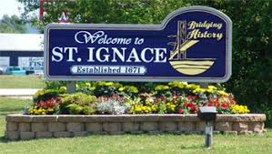
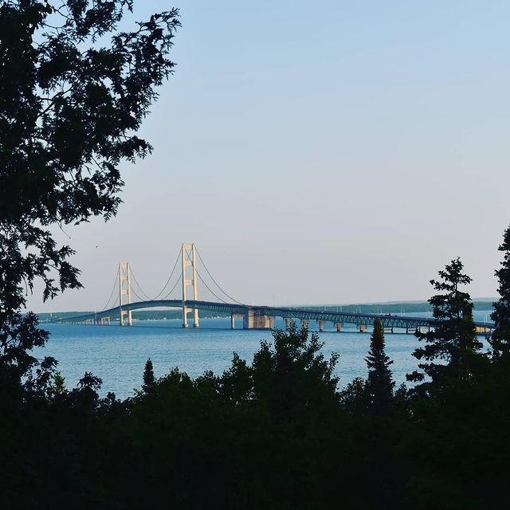
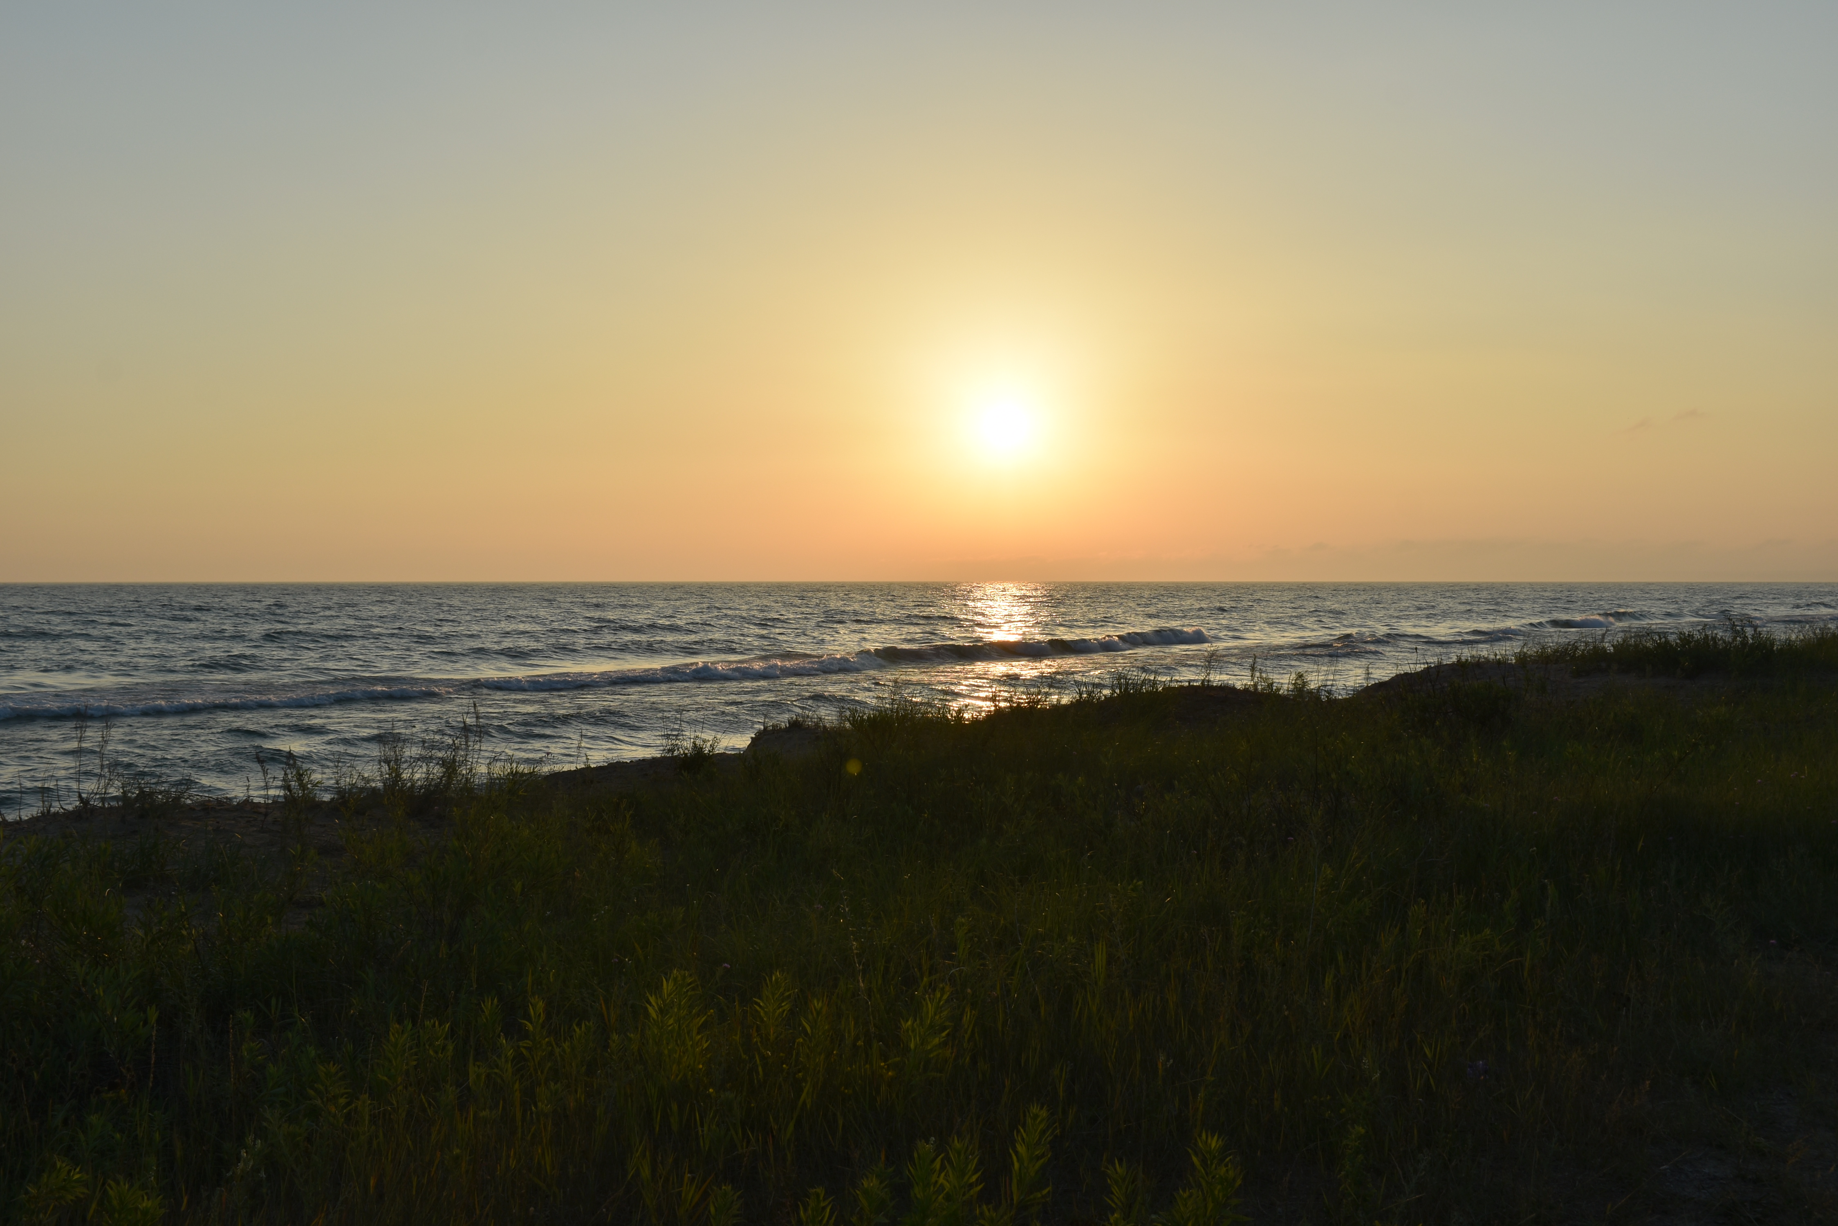
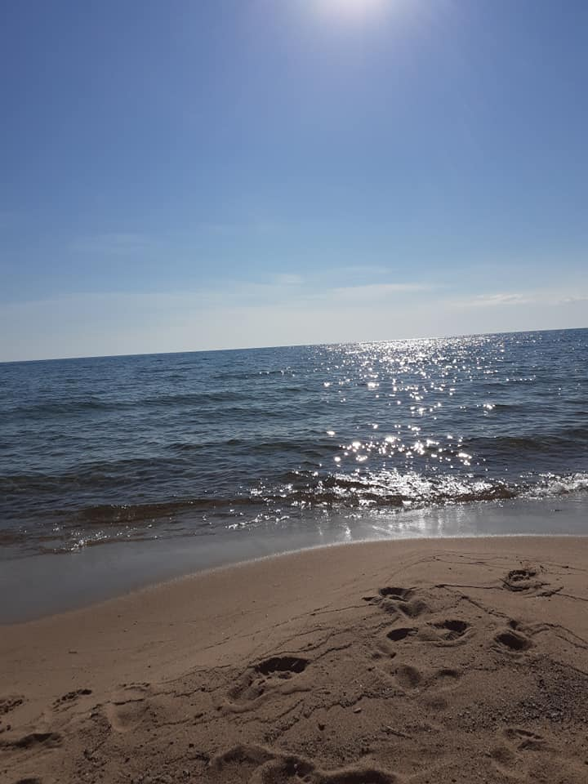
THRIFTY TOURISTS’ GUIDE TO ST. IGNACE
Published by Saint Ignace Chamber of Commerce
2021
For locations of in-town events, please consult a free downtown St. Ignace map. A visit to the St. Ignace Chamber of Commerce (560 N. State Street) is the best place to start.
call 906-643-8717 or email info@saintignace.org
The City & State maps, brochures for lodging, dining and attractions, directions and answers to your questions are available there. Additionally, one Mackinac County road map (per family) is available free-of-charge from the Mackinac County Road Commission (706 N. State St.),
M-Th 6-4:30 from May to Oct. & M-F 7-3:30 Winter Hours. Phone: 906-643-7333.
Music Credit: AShamaluevMusic
Photo Credit: City of St Ignace
Photo Credit Karen Sue Photography
Photo Credit Karen Sue Photography
Photo Credit Karen Sue Photography

Slide 2
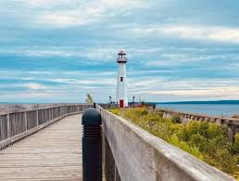
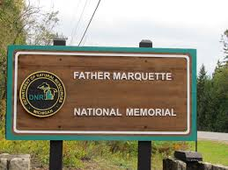
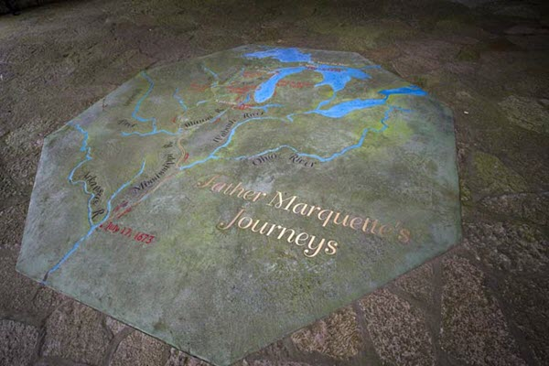
Huron Board Walk
Father Marquette
The Huron Boardwalk ribbons along the shore from Kiwanis Beach Park one mile-plus to the Wawatam Lighthouse. The booklet will guide you along the boardwalk and back along the west side of State St. The centerfold in the booklet gives amenities available along the route. Parking is available. At the north end, park behind the Museum of Ojibwa Culture. Walking tour books are available at the St Ignace Chamber of Commerce.
Father Marquette Memorial Park
Take US-2 west 1/10 mile beyond I-75, turn south (left) on Boulevard Drive (same as above) & at 2/10 of a mile, turn east (left) at the banner into the parking lot. This park has a 15-stop interpretive history/nature trail, bridge view, and the Father Marquette story
Photo Credit: Stignace.com
Photo Credit: Michigan.gov

Slide 3
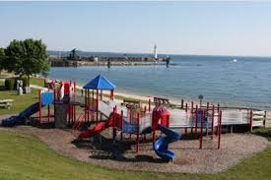
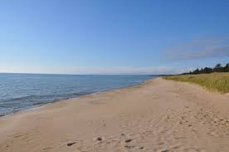
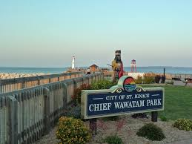
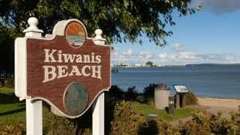
Beaches
Playgrounds
American Legion Park
Located Downtown across from True Value Hardware.
This Public Beach is located on Lake Huron
-------------------------------------------------------
Kiwanis Beach Park
Located along the Huron Boardwalk
Between Star Line Ferry and Indian Village
--------------------------------------------------------
Lake Michigan Sand Dunes
Travel west on US-2 about 10-12 miles (beyond I-75). The sandy beach stretches for miles here. Parking is permitted on the shoulder of the highway. There are no facilities, no lifeguards and no food available to buy…so bring your own picnic.
Dock #3 City Park/Coast Guard Park
At the end of Ferry Lane
------------------------------------------------------
American Legion Park
Located Downtown across from True Value Hardware.
------------------------------------------------------
Chief Wawatam Park is connected to the Historical Board Walk and takes you down into Lake Huron and by the Wawatam Lighthouse.
There is also a splash pad for kids to run through on the hot days of summer. Beautiful view of Mackinac Island and all the Freighters and boats going through the channel.
Photo Credits: Stignace.com

Slide 4
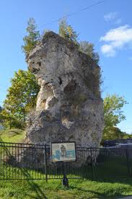
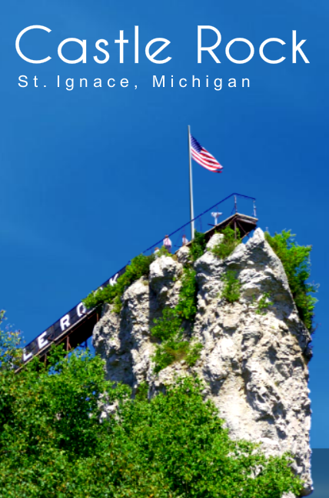
Sea Stacks
St. Anthony’s Rock
(see city map)
There is an informational plaque in front of the rock that gives details on its history and possible name origin
Castle Rock
Just north of town, follow N. State St., cross over the I-75 overpass and turn right- into the parking lot. Great views from the top and say “Hi” to Paul Bunyan and Babe, the Blue Ox (Nominal admission fee)
St. Anthony’s Rock is one of several ‘sea stacks’ in the Straits Area. It is made of Mackinac breccia, a type of stone formed 350 million years ago, when the roofs of deep caves collapsed into stacks of fragmented rock. Calcium carbonate in circulating groundwater cemented the stacks of limestone, dolomite and chert into much harder formations than surrounding unbroken limestone. Much later, glaciers covered this area, then began melting about 12,000 years ago. Wave action in the resulting lakes eroded the adjacent soft stone, leaving St. Anthony’s Rock exposed by 2000 B.C.
Photo Credit: travelthemitten.com
Photo Credit: castlerockmi.com

Slide 5
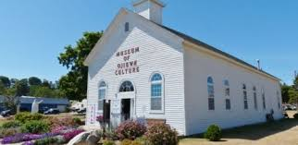
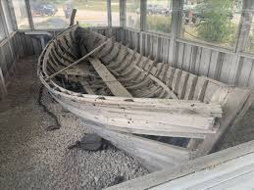
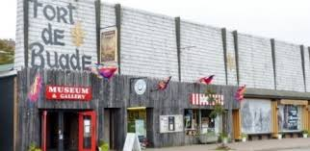
Museums
Museum of Ojibwa Culture
500 N. State Street
Museum admission is free (donations most welcome).
For info visit: museumofojibwaculture.net
Please visit their website for a schedule of museum events, cultural nights and walking tours
(906) 643-6076
Fort De Buade
334 N. State St.
Museum admission is free
(donations most welcome).
For info visit: www.fortdebaude.com
(906)-643-6627
Mackinaw Boat Edith Jane
Visit Mackinaw Boat Edith Jane. She is located in her own small viewing building on North State Street across from the end of Central Hill Street. Her story is presented there, as well.
Photo Credits: Stignace.com

Slide 6
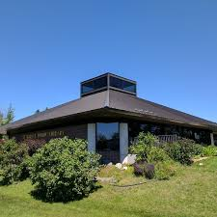
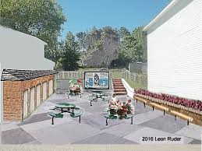
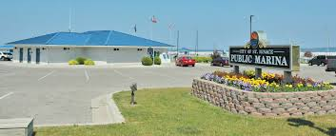
St Ignace Public Library
Public Restrooms
Computers to use at no charge.
Wireless access with your laptop, even outside during open hours.
A cart full of used books always on sale for a very low price $.
(906) 643-8318
Address: 110 West Spruce St. (corner of Business Loop-75
Public Restrooms are available at:
St. Ignace Public Marina
St. Anthony’s Pocket Park
American Legion Park
Photo Credits: St Ignace Public Library
Photo Credit: Patroncity.com
Photo Credit: greatlakesfishermansdigest.com

Slide 7
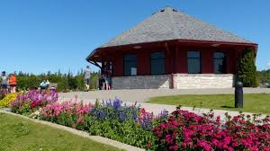
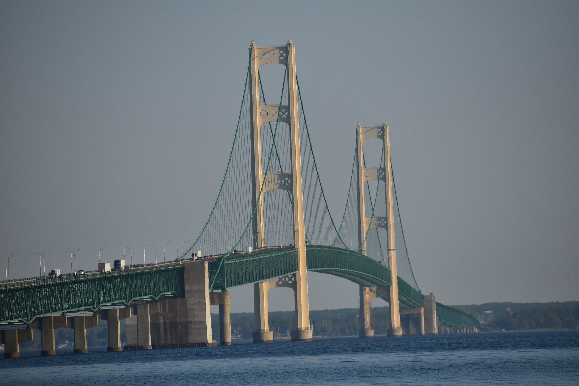
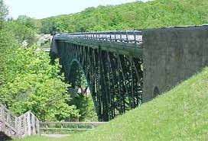
Bridge Viewing
Bridgeview Park
Peaceful lakeside park offering scenic bridge views, benches, walking paths & restroom facilities.
Address: W69 Boulevard Dr, St Ignace, MI 49781
Beautiful Mackinac Bridge views
Day and Night
Cut River Bridge
Travel US-2, west of I-75 for 25 miles. This bridge spans the Cut River Gorge. The roadside parks at each end of the bridge offer off-road parking, walkways on and under the bridge, pitcher pumps for water (in season), nature trails and steps down to the river, then a trail along the river to Lake Michigan’s sandy beach. There is also a small footbridge across the Cut River near the beach. With a picnic basket, you could spend a whole day here
Photo Credit: stignace.com
Photo Credit: Karen Sue Photography
Photo Credit: Michigan.gov

Slide 8
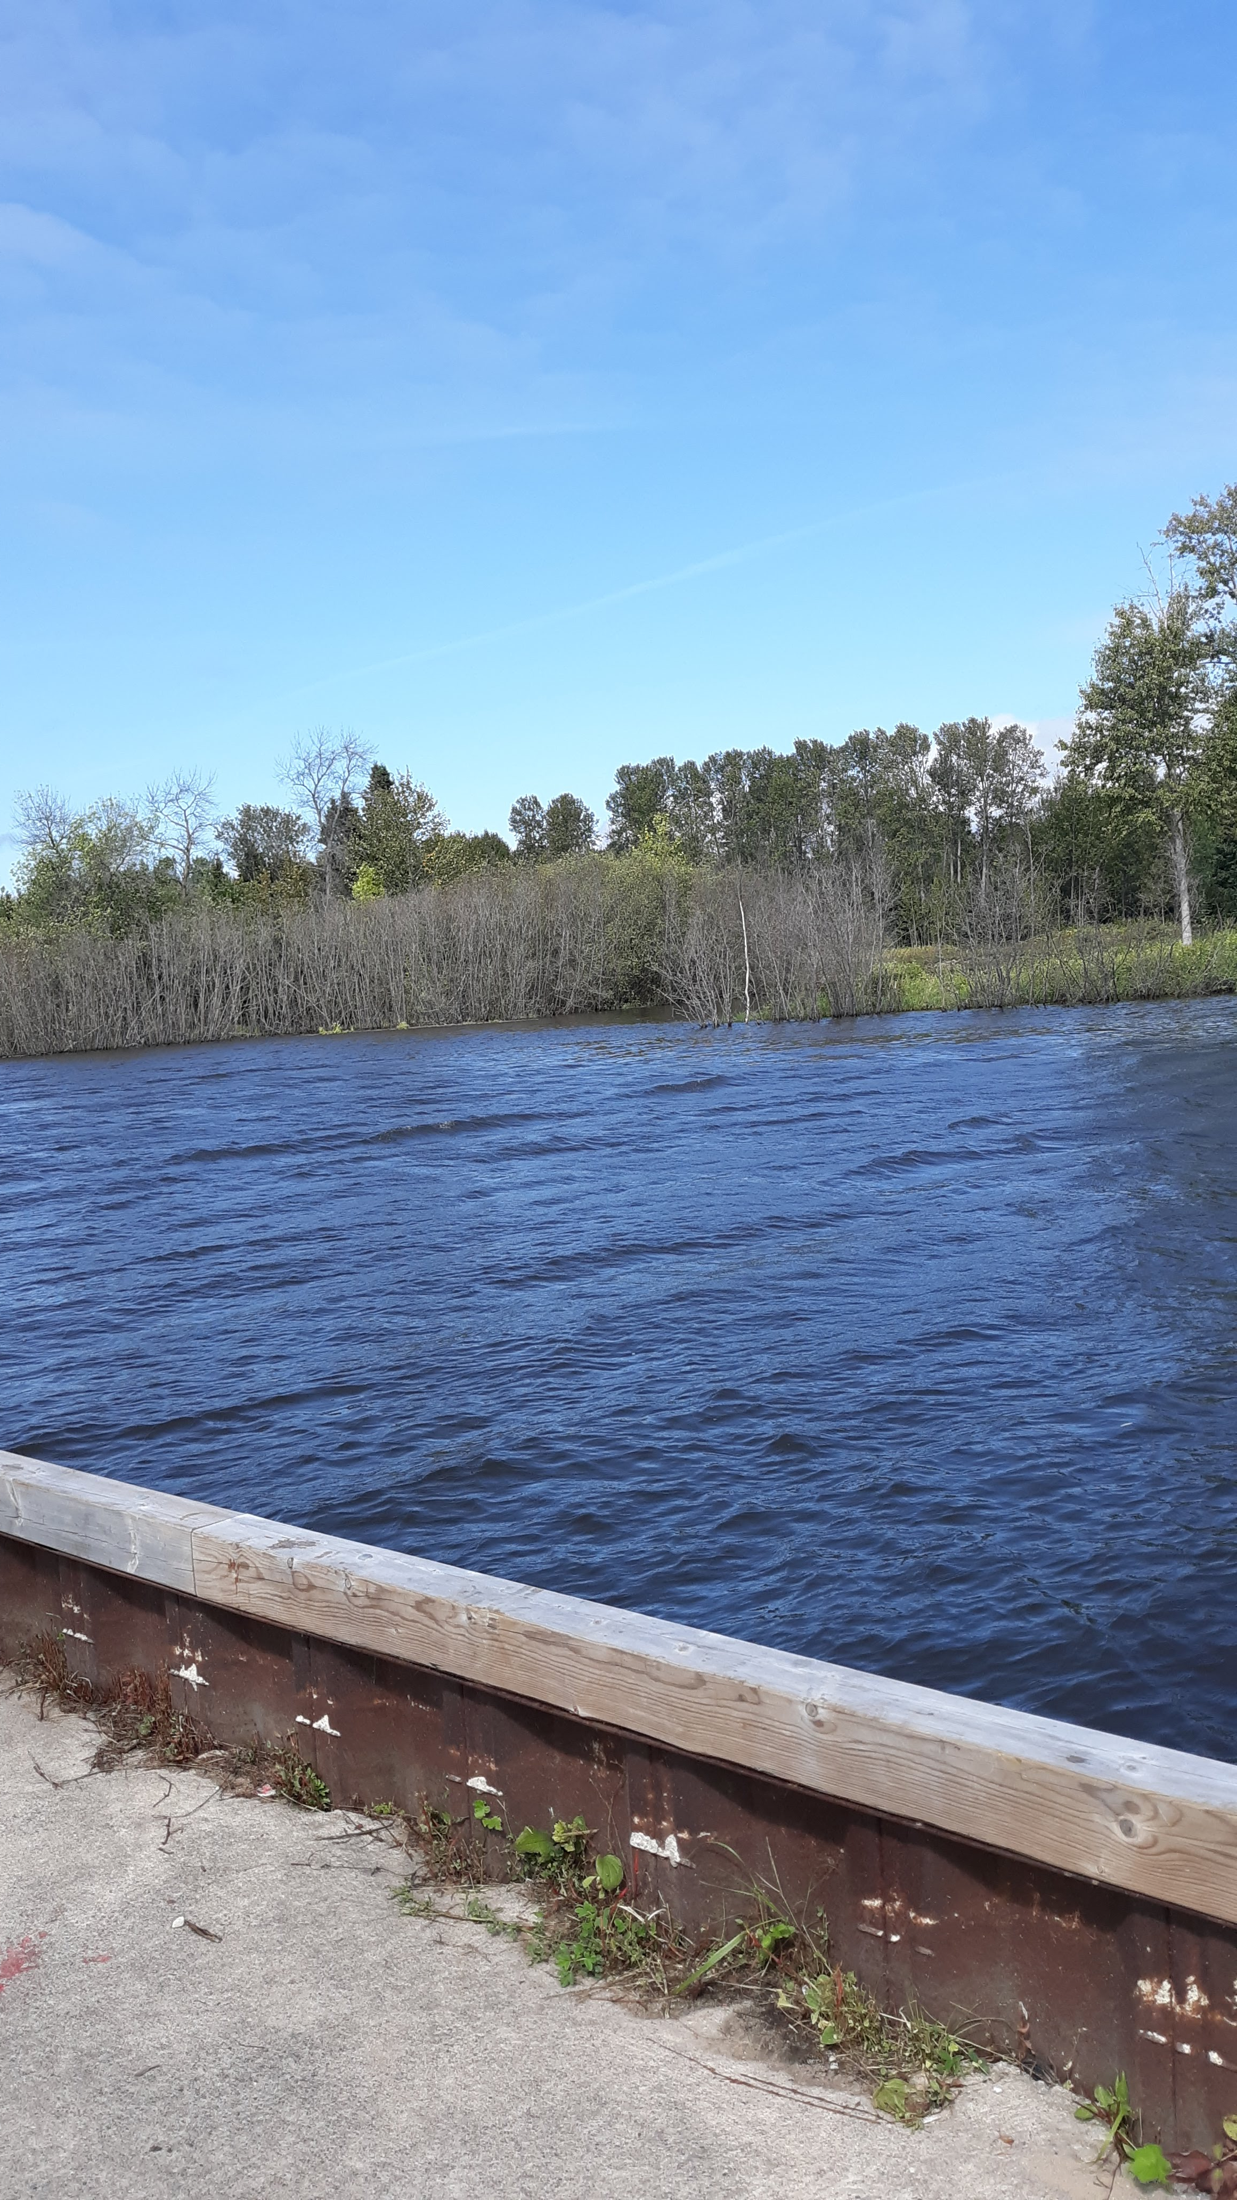
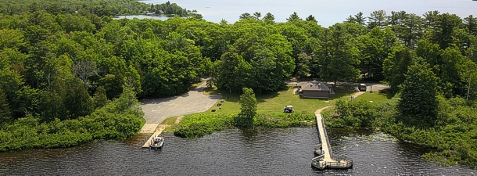
Fishing Please bring a paper map with you, GPS and Cell phone signals can be unreliable
Carp River Fishing
Fishing at the mouth of the Carp River.
Head north on I-75 to exit #352 (M-123)
or travel north along Mackinac Trail to M-123 intersection.
Turn north (left from M-123) (or continue straight north if you are on Mackinac Trail already),
Drive 4 miles. You will be at an I-75 overpass – turn right on Carp River Road (a gravel road which is parallel to and just before I-75) – sorry, no road sign here (almost adjacent is Gorman Road…paved).
Drive 4/10 of a mile on the gravel road to US Forest Road #3127 (paved) turn right.
Stay on pavement 1 mile. Pavement ends near boat launch (launch ramps aren’t paved…for small boats only).
Continue into gravel parking circle 1/10 mile to (R- rustic). This fishing site is rated as barrier-free, follow concrete sidewalk to pier.
You can cook the fish you catch right here at 2 fire pits (bring your own firewood or charcoal). You may also walk along and fish from a short footpath by the river just north of the pier. Bring your own bait and tackle…and maybe lawn chair(s) and a picnic, as well
Brevort Lake Campground:
Fish off the dock at the campground for free! Or if you have a boat drop it in the water and go out and fish away!
Directions from the Chamber: Head west on E Goudreau Ave toward Mary St,
Turn left at the 2nd cross street onto N Marley St,
Turn right at the 1st cross street onto Portage St,
Turn left to stay on Portage St, Turn right onto US-2 W,
Turn right onto Forest Service Rd 3108,
Turn right onto Park Ln, Slight right to stay on Park Lane, Destination will be on the right
Brevort Lake Campground, N 4149 Camp Rd.,, St Ignace, MI 49781
Photo Credit: Fishweb.com
Photo Credit: Karen Sue Photography

Slide 9
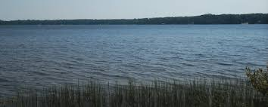
Fishing Please bring a paper map with you, GPS and Cell phone signals can be unreliable
Trout Lake
(Scenic Route, passage may be difficult depending on the season)
Fish off the Beach or Dock or Drop your boat in the water and cruise out to the middle.
Directions from Chamber: Head west on E Goudreau Ave toward Mary St,
Turn left at the 2nd cross street onto N Marley St, Turn right at the 1st cross street onto Portage St,
Turn right to merge onto I-75 N toward Sault Ste Marie ,Merge onto I-75 N, Take exit 352 for M-123 toward Newberry, Turn left onto M-123 N,
Turn left onto Worth Rd, Turn right onto Town Line Rd,
Turn right onto Ozark Trail, Continue onto Carp River Rd, Continue onto S Carp River Truck Trail,
Turn right to stay on S Carp River Truck Trail,
Turn left at the 1st cross street onto W Huckleberry Lake Rd,
Turn right onto S O J Miller Rd, Destination will be on the right
Trout Lake Resort, 22477 S O J Miller Rd, Trout Lake, MI 49793
Trout Lake
(Direct Route)
Take I75 North to Exit 352
Turn Left
Stay on 123 and follow the signs to Trout Lake
Photo Credit: exploringthenorth.com

Slide 10
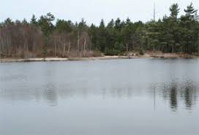
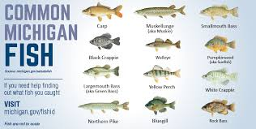
Fishing Please bring a paper map with you, GPS and Cell phone signals can be unreliable.
Castle Rock Fishing Ponds
Four stocked ponds to fish in from the wilderness shore.
Follow State St. north and cross over the I-75 overpass.
Turn left almost immediately into West Lant Road, drive 1/10 mile
turn right on US Forest Road #3104 (Castle Rock Road. You will be turning right just before a ‘dead end’ sign.)
Drive 2.7 miles and turn left on unnumbered US Forest Road – you will see the first pond right away.
You choose which of the four ponds you want. These ponds require a regular fishing license but no admission charge: no facilities, no food concession – and – bring your own tackle and bait and bug repellent. Enjoy the quiet and solitude
*State of Michigan Free Fishing Weekend is the second weekend in June and allows any person to fish without a license on these two days.
*However, all other State fishing laws apply.
*Thank you for NOT fishing from the St. Ignace City Marina piers.
*Fish Cleaning Station located at boat launch (R), Stockbridge and Hazelton Streets, and at Dock #3, City Park.
Photo Credits: Michigan.gov

Slide 11
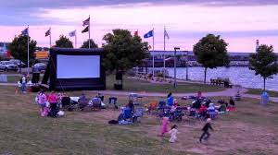
Weekly Events
Please enjoy our downtown events
Music
Fireworks
Farmer’s Market
Movies By The Bay
Please visit our website for an update calendar of events: Saintignace.org
Photo Credit: stignace.com
Photo Credits: stignacebudgethost.com

Slide 12
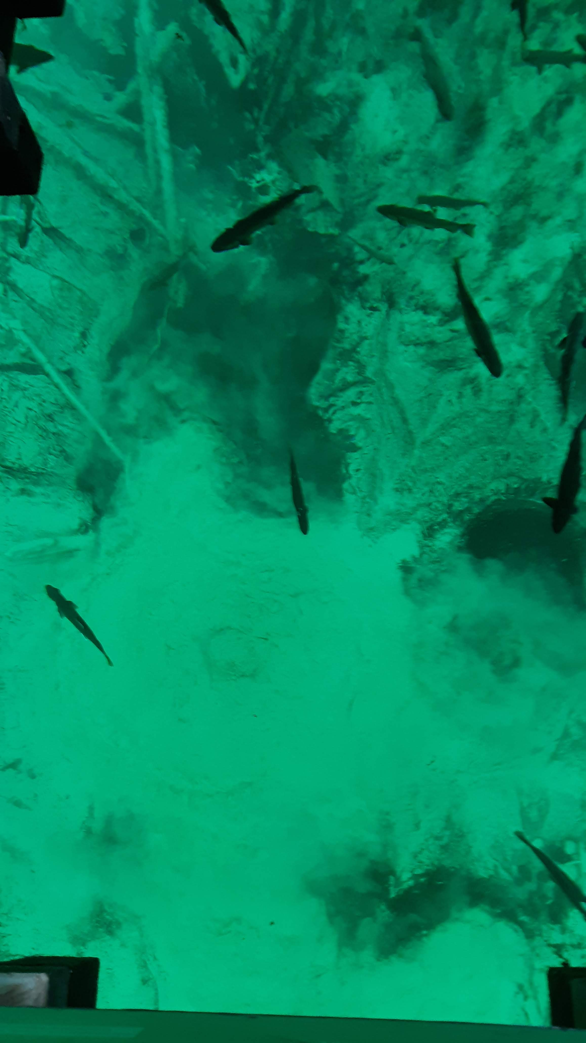
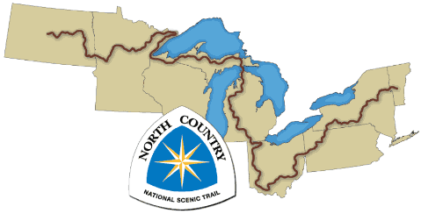
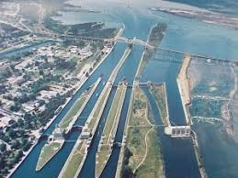
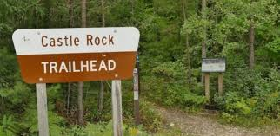
Local Attractions
Photo Credit (top row): Karen Sue Photography
The Eastern Upper Peninsula has many great, low-cost attractions within a 90 minute drive.
Photo Credit: northcountrytrail.org
Photo Credit: shipwreckmuseum.com
Photo Credit: Stignace.com

